Slide 1
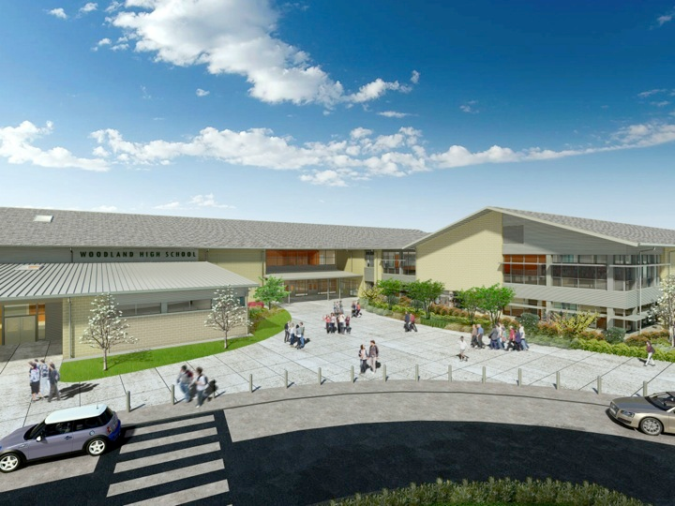
Woodland Public Schools
Facilities Report November
2022

Slide 2
Facilities Report
Office Security Installation Update – Installation of an improved office security system is currently underway at WHS, WMS, NFES, and CES. This upgrade includes, multiple enable points for lock down, panic, and momentary release controls for evacuations. This work is close to completion. We expect this to be complete by December 1st. We are looking into expanding this project by adding an additional measure of security to our School’s offices, with remote buzz in and out exterior door operation, video and voice two-way communications to qualify visitors to the School, before allowing them into our facilities.
Air Purification Systems Update – Completed the air purification system installation at NFES, WHS and WMS. We will be installing the in-room purification systems at CES and Yale this month. We expect this to be completed by December 1st.
In September and October, we closed 65 work orders, with 37 in progress.
Reviewed utility expenses for September/October billing cycle. All utility costs came within historical averages with the exception of Yale Elementary. Yale’s electrical usage was up 16% for air conditioning with the new heat pump systems. Yale’s net annual heating and cooling expenses should be much lower than what we were spending annually on heating fuel oil.

Slide 3

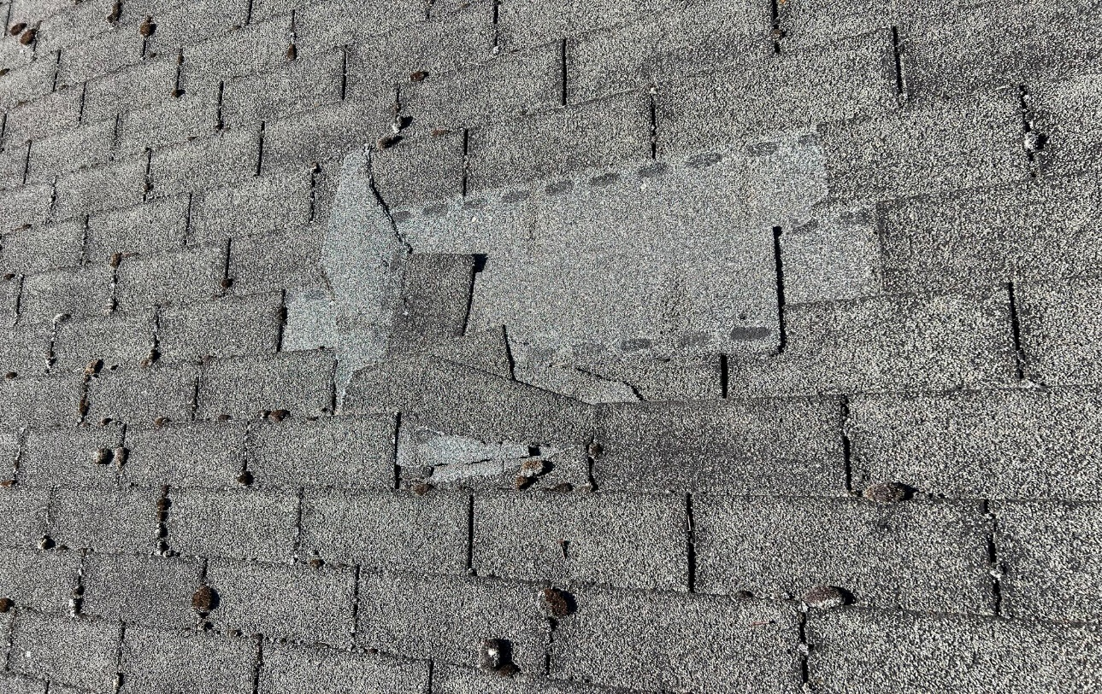
Future Facilities Projects: 2023
Columbia Elementary Siding Repair
Replacing 50 year old siding
Estimated cost $31,000
Woodland Middle School Roof replacement
Replacing 30 year old roof
Estimated cost $417,000 plus tax

